Slide 1


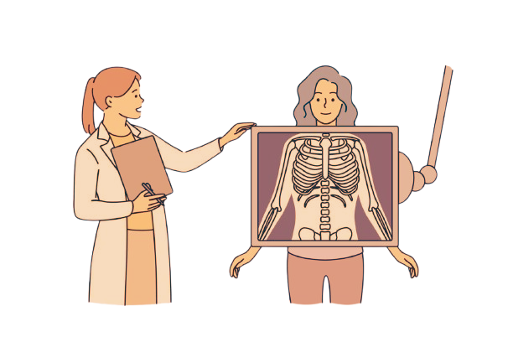
REVOLUTIONIZING PNEUMONIA DIAGNOSIS: HARNESSING THE POWER OF DEEP LEARNING TO PREDICT PNEUMONIA FROM X-RAY IMAGES WITH PRECISION AND SPEED.

Slide 2



Pneumonia remains a major health threat, especially for children and the elderly, requiring fast and accurate diagnosis. Traditional X-ray analysis relies heavily on medical experts, often causing delays and inconsistencies.
INTRODUCTION

Slide 3



The main purpose of our project consists of utilizing deep learning methods to develop a simplified system that detects pneumonia through chest X-ray imaging.
Custom Built CNN
RESNET
DENSENET
VGG16
INCEPTIONNET
#1 APPLICATION DEVELOPMENT WITH RESNET
#2 MODEL PEROFORMANCE COMPARISON
#3 DASHBOARD
OBJECTIVE

Slide 4
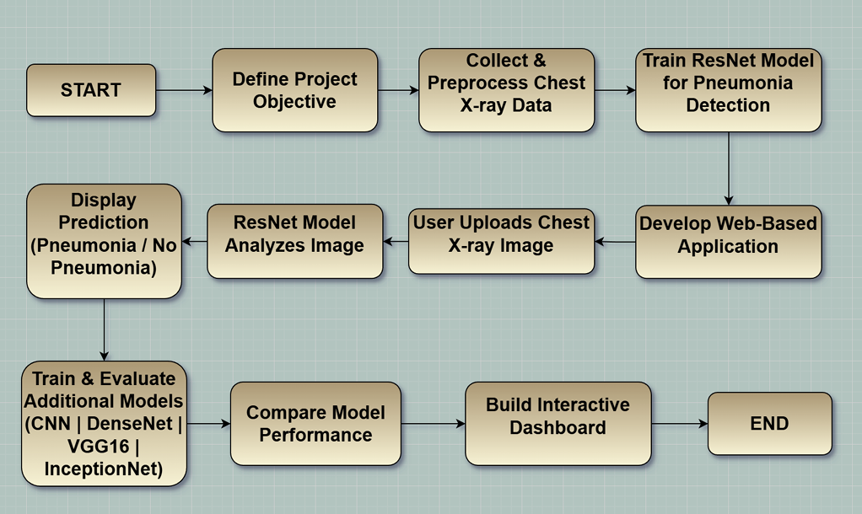

FLOWCHART

Slide 5
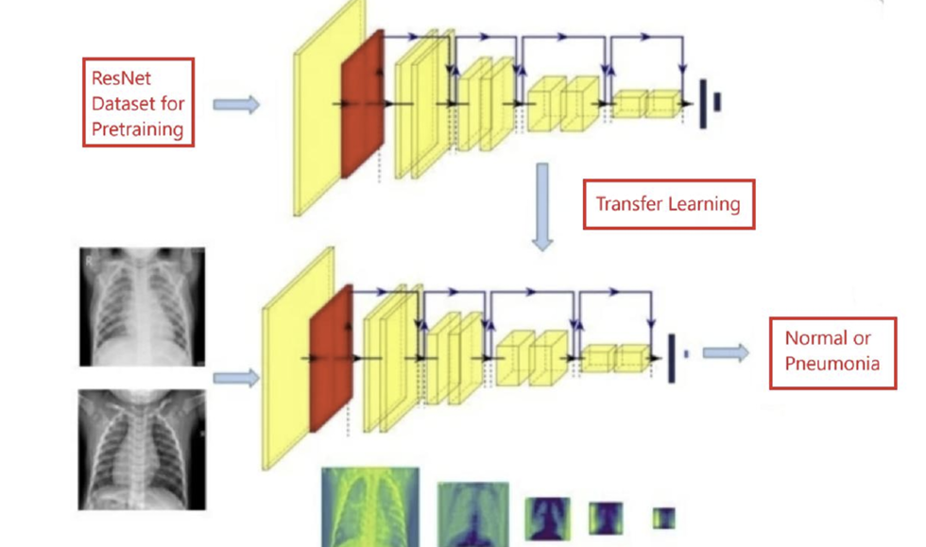
THE ALGORITHM’S FLOWCHART

Slide 6
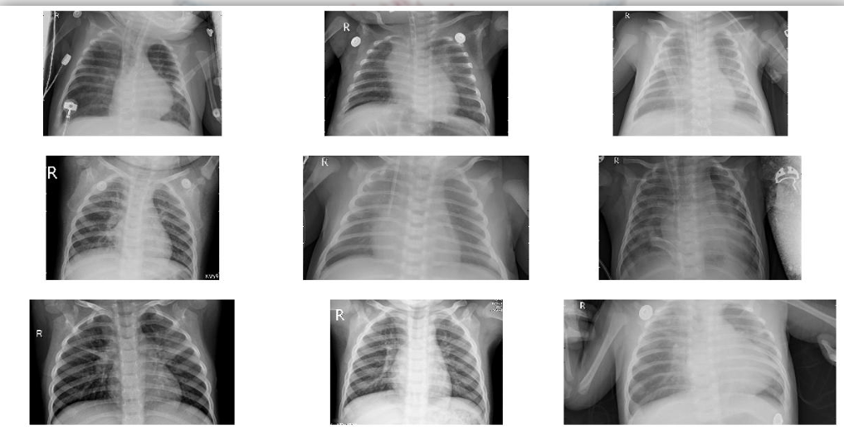

HOW OUR DATASET LOOKS ALIKE?

Slide 7
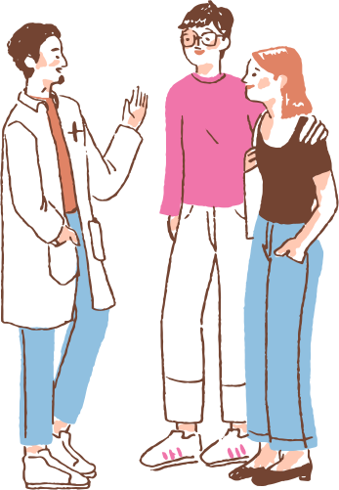
PROPOSED METHODOLOGY
Our methodology is structured into five phases:
1. Data Preparation
2. Development of model
3. Evaluation
4. Web Application Integration
5. Dashboard Visualization

Slide 8
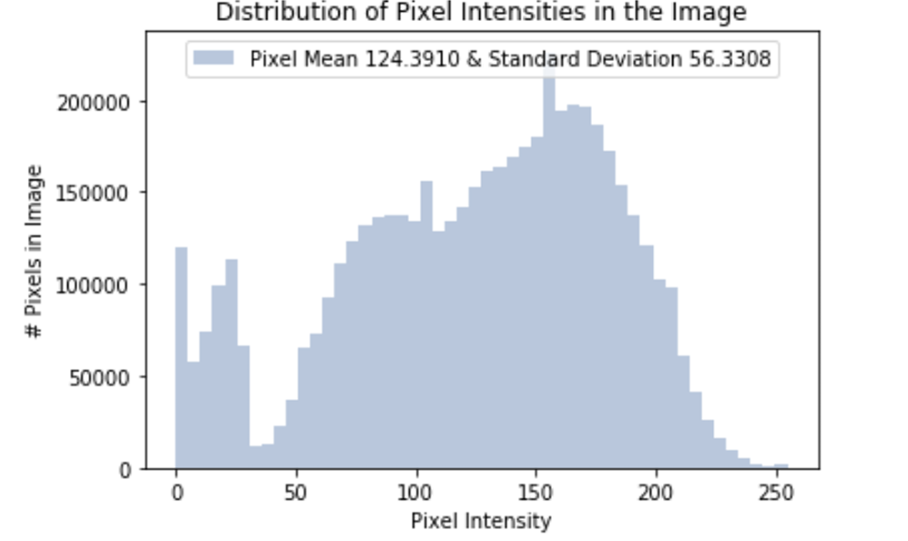
We got average pixel value of our dataset around 124.39. Since the value typically between the 0 to 255, so it means our image dataset is neither too dark nor too bright but moderate intensity.
IMAGE PREPROCESSING (INVESTIGATE PIXEL VALUE DISTRIBUTION

Slide 9
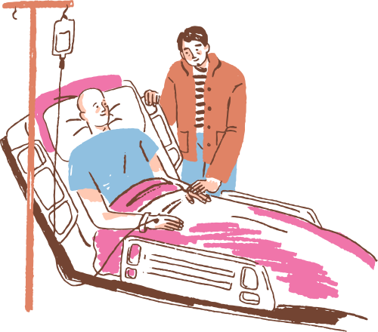

DISCUSSING RESULTS
AFTER MODEL IMPLEMENTATIONS

Slide 10
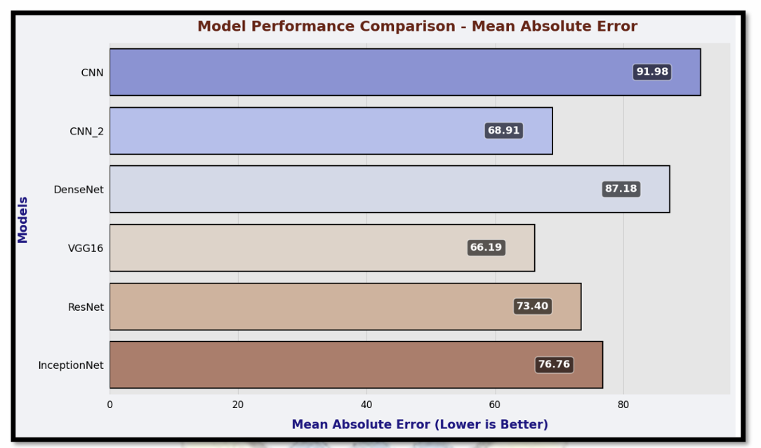
BEST MODEL IS VGG16
THE ABOVE VISUALIZATION COMPARES THE MEAN ABOSLUTE ERROR VALUES OF THE DIFFERENT MODELS WHICH WE USED AND TRAINED IN OUR PROJECT.

Slide 11
EXCITING FOR OUR APPLICATION

Slide 12
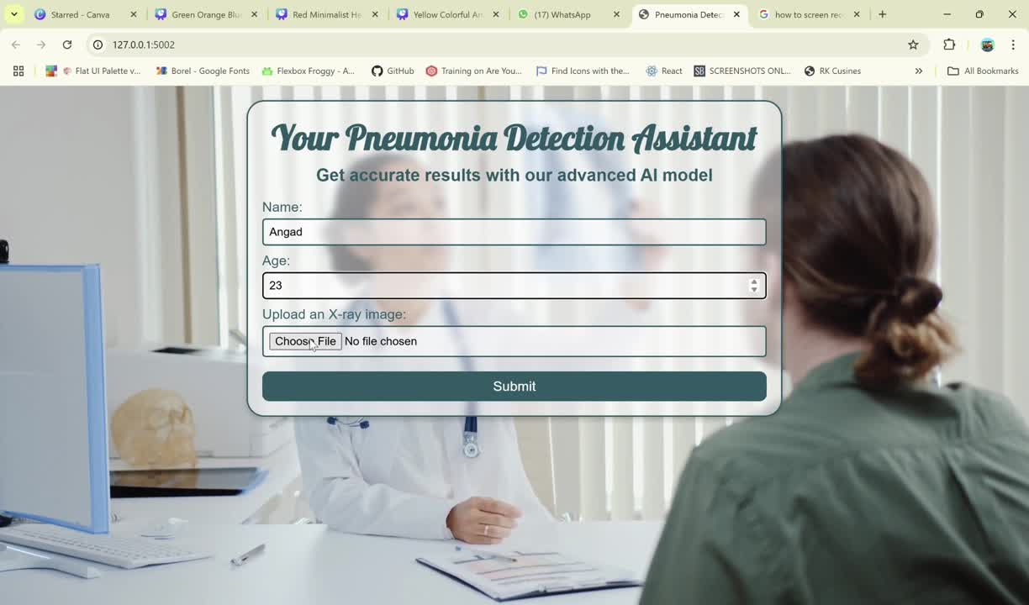
VIDEO REPRESENTATION OF OUR APPLICATION

Slide 13
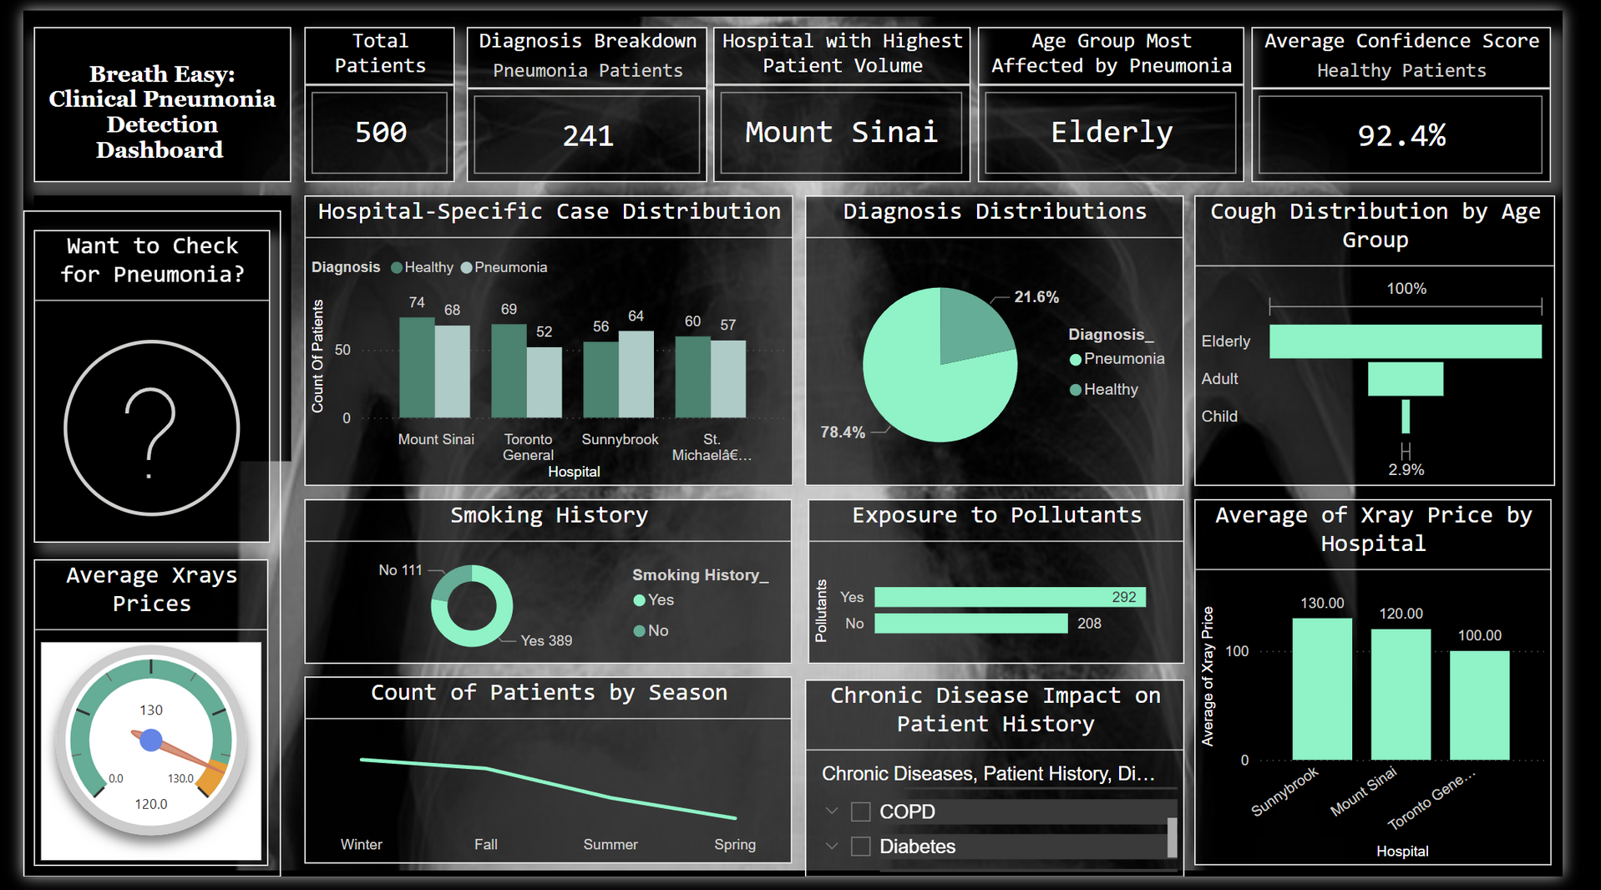
OUR DASHBOARD

Slide 14

References
GOOGLE COLLAB FILE HTTPS://COLAB.RESEARCH.GOOGLE.COM/DRIVE/1WSN9ILWL4Q4VFGBTGEUQBLFTWEL7KQCI?USP=SHARING DATASET AND RESARCH (KAGGLE)
HTTPS://WWW.KAGGLE.COM/CODE/ASHISHPATEL26/CHEXNET RADIOLOGIST-LEVEL-PNEUMONIA-DETECTION/NOTEBOOK RSEARCH PAPER
HTTPS://BMCMEDIMAGING.BIOMEDCENTRAL.COM/ARTICLES/1 0.1186/S12880-023-01174-4
FLOW CHART
HTTPS://APP.DIAGRAMS.NET/-----

Slide 15

THANK YOU FOR LISTENING

